Slide 1

ADVISOR
STUDENT
Dr. Eng. Dhany Arifianto, ST., M.Eng
Muhamad Haykal Hanif Gifari Adi
02311940000154
Designing and Infrasound-based Regional Volcano Monitoring, Classification and Forecasting for Anak Krakatau

Slide 2






I
Background
Motivation
Volcanic eruptions have killed more than 300,000 people worldwide since the 16th century, with Southeast Asia accounting for more than half of this total
Current forecasting and early warning system method are still overly reliant on event count process
Infrasound has proven effective to employ infrasound for near-real-time eruptions at volcanoes,

Slide 3
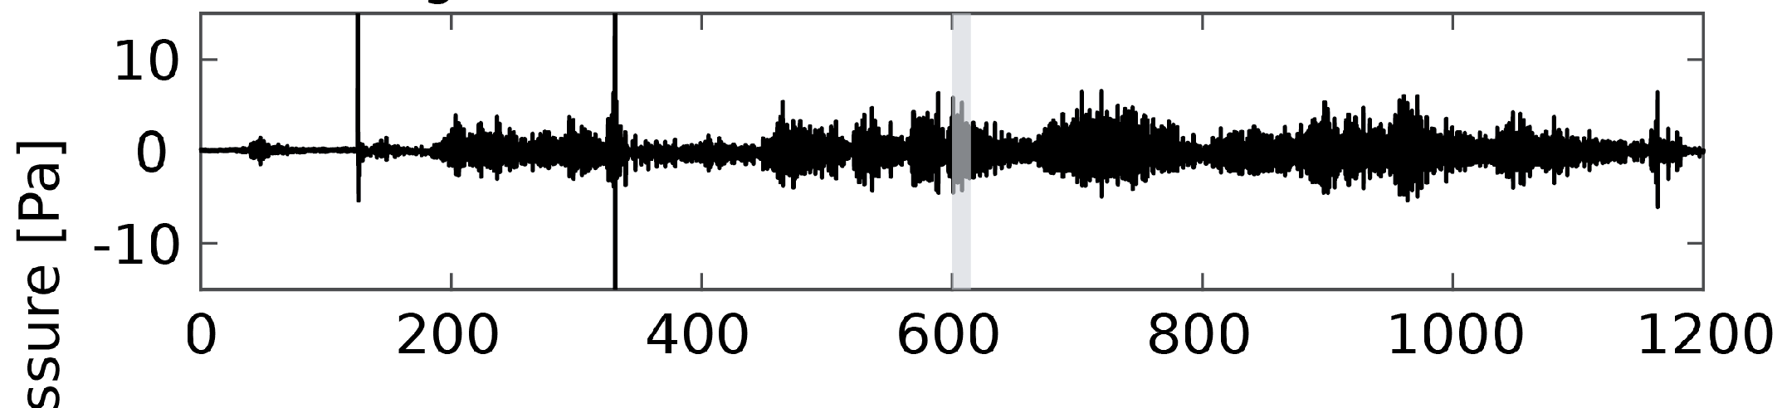
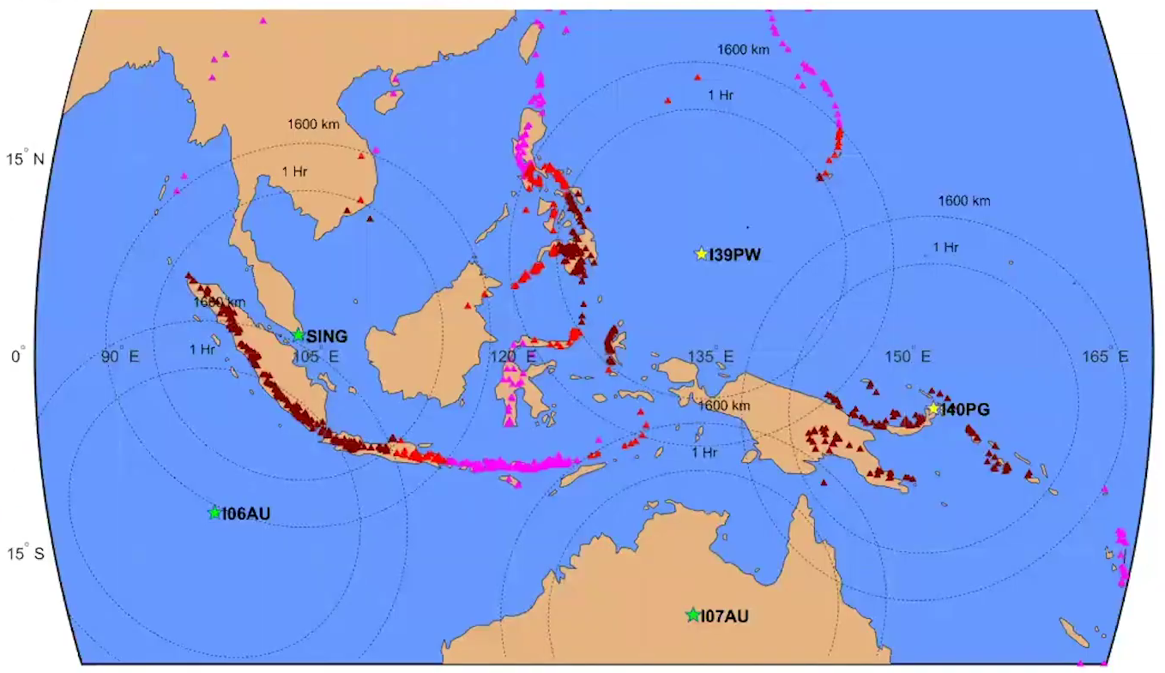

I
Theoretical Framework
Volcanic Infrasound Signals
Volcanic eruptions produce low frequency (<20 Hz) infrasonic signals to the atmosphere. It can be used to:
Detect eruptions (Arnoult et al., 2010)
estimate volume and height of erupted material (Caplan-Auerbach et al., 2010)
track changes in eruptive activity (Garcès et al., 1999)
provide constraints on magma movements (Richardson et al., 2014)
1
Notes:
Erupsi gunung berapi menghasilkan sinyal infrasonik terhadap atmosfer. Sinyal inilah yang kemudian dapat diteksi oleh stasiun IRIS sebagaimana yang telah diperlihatkan pada peta disamping.
Sinyal inilah yang akan menjadi dasaran bagi pengerjaan kita, karena telah terbukti dari berbagai literatur bahwasanya Infrasound dapat dipakai untuk mendeteksi erupsi, estimasi kettingian, mengetahui perubahan pada aktivitas vulkanik dan memberikan batasan pada pergerakan magma.
Tetapi bagi literatur yang berbasis infrasound, terlihat bahwa Early Warning System hanya memanfaatkan keuntungan fisis dari infrasound dalam mengejar waktu.

Slide 4
II
Research Objective
1
To develop and refine methodologies for the effective extraction of infrasound signals associated with volcanic activity.
2
To interpret patterns to gain insights into the underlying processes and dynamics of volcanic systems.
3
To test and validate eruption forecasting to ensure its reliability and accuracy in predicting volcanic eruptions.
2
Notes:
Maka dari itu, dapat disimpulkan tujuan atau objective dari studi ini akan

Slide 5
III
Methods
Software
Object
Python
Mt. Krakatau, Sunda Strait
limited to the development of the early warning system for Mount Krakatau
3
Notes:
Untuk Batasan masalah dari penelitian ini adalah objek yang kita kaji hanya spesifik pada gunung Anak Krakatau, specific pada periode erupsi tahun 2018
Untuk Software kita akan menggunakan Python dengan library yang akan dijelaskan pada metodologi
Dan untuk hasil akhir adalah diharapkan output dari project ini adalah adanya Sistem yang cukup cepat dan akurat dalam mengantisipasi erupsi gunung berapi
Hasil akhir ini adalah kita akan meliaht

Slide 6
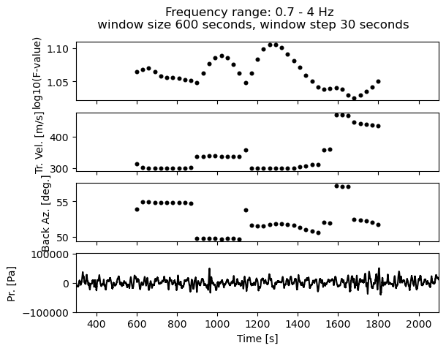
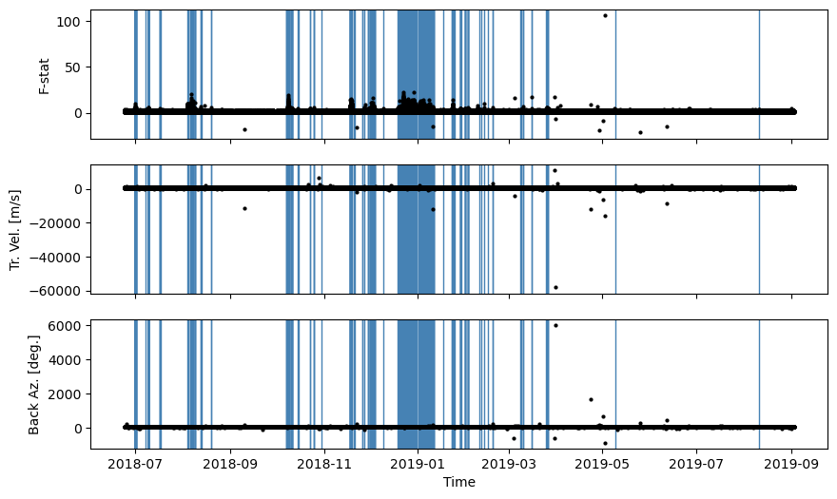
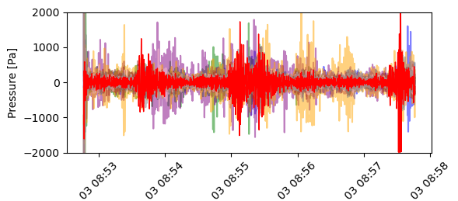
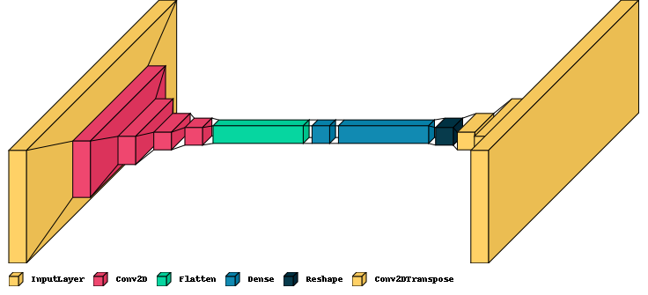
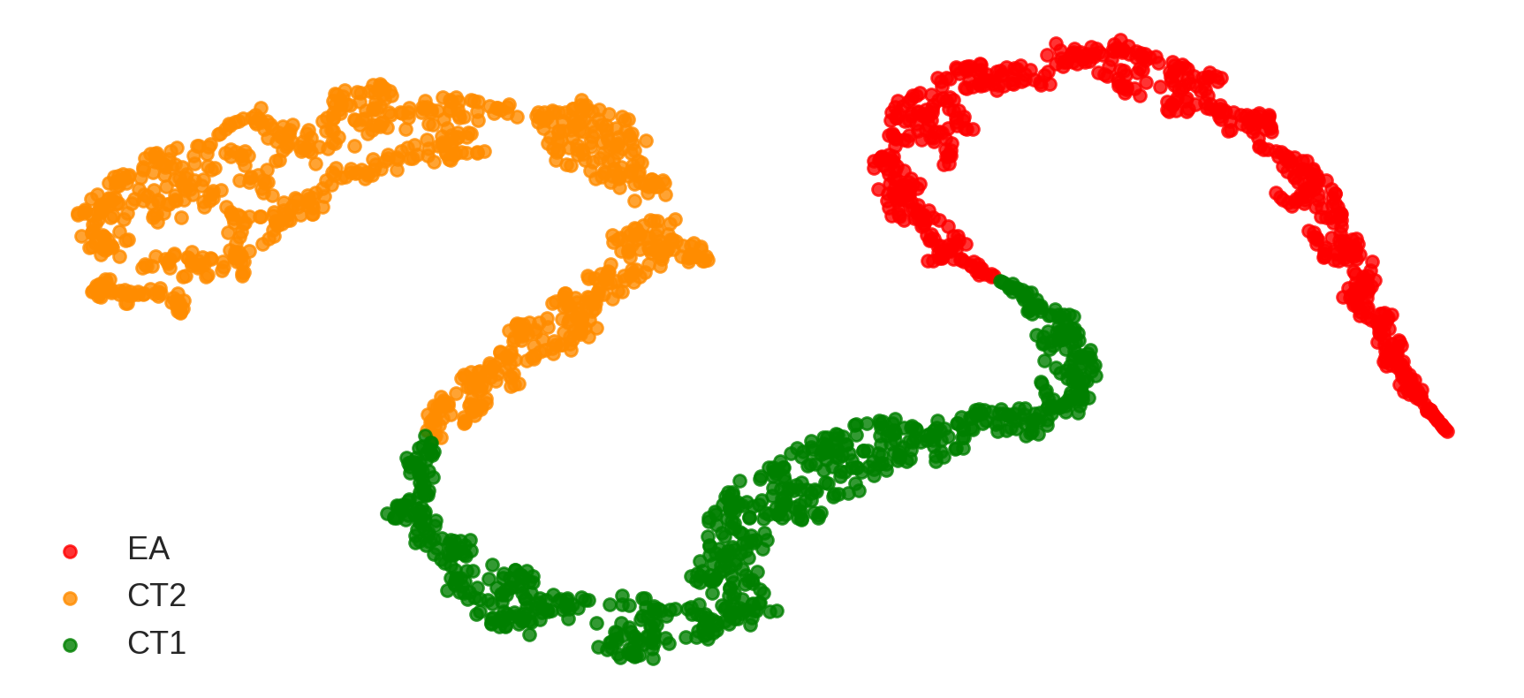
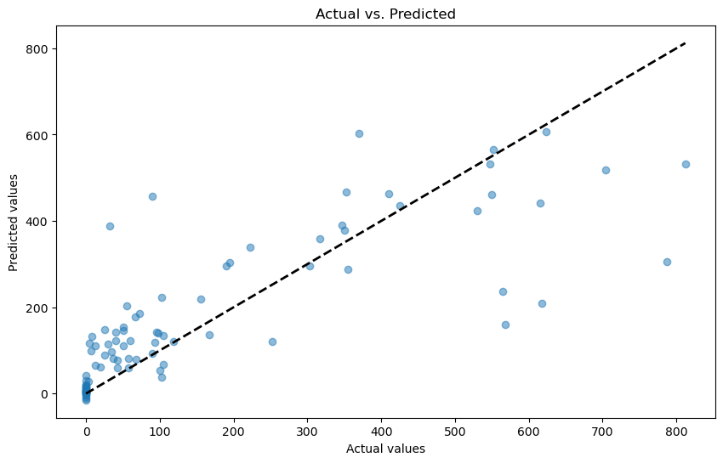
III
Methods Outline
1
Source Separation
2
Signal Segmentation
3
Signal Denoising
Laslo’s Best beam
Bartlett Beamforming
Adaptive F-Detector
4
Dimensionality Reduction
5
Clustering of seismo-acoustic activity
6
Forecasting Eruption Events
Automatic Feature Extraction using Convolutional Autoencoder
Deep Embedded Clustering (Unsupervised)
Gradient Boosted Trees
4
Notes:
Sebagaimana bisa dilihat, methodologi saya kurang lebih berjumlah enam bagian.
Bagian pertama adalah source seperation; dimana sinyal dari sumber recording 360 derajat dicarikan “angle of arrival (backazimuth)” nya dengan proses bartlett beamforming.
Selanjutnya, sinyal tersebut akan diberikan “Adaptive F-Detector” untuk memilih bagian bagian relevan terhadap aktivitas vulkanis pada anak Krakatau
Ketiga, sinyal akan di “denoising”, Denoising merupakan teknik penghilangan noise pada sinyal dan mempertahankan informasi yang penting, pada bagian ini saya menggunakan Laslo’s best beam method
Keempat, sinyal tersebut kita ubah kepada Frequencial domain menggunakan Short Term Fourier Transform (STFT), dan hasil tersebut kita masukkan kedalam autoencoder, dimana dari hasil STFT tersebut dikecilkan menggunakan sebuah encoder sehingga kita mendapat “encoded result”
Encoded result ini, kita kenakan Deep embedded clustering (DEC) Dimana akan di indentifikasi categori2 berdasarkan latent space yang sudah ada. Proses ini membuat kita mengerti fase-fase aktivitas anak krakaktau
Terakhir, latent space tersebut akan dipakai untuk meramal kapan akan terjadinya erupsi menggunakan gradient boosted trees

Slide 7
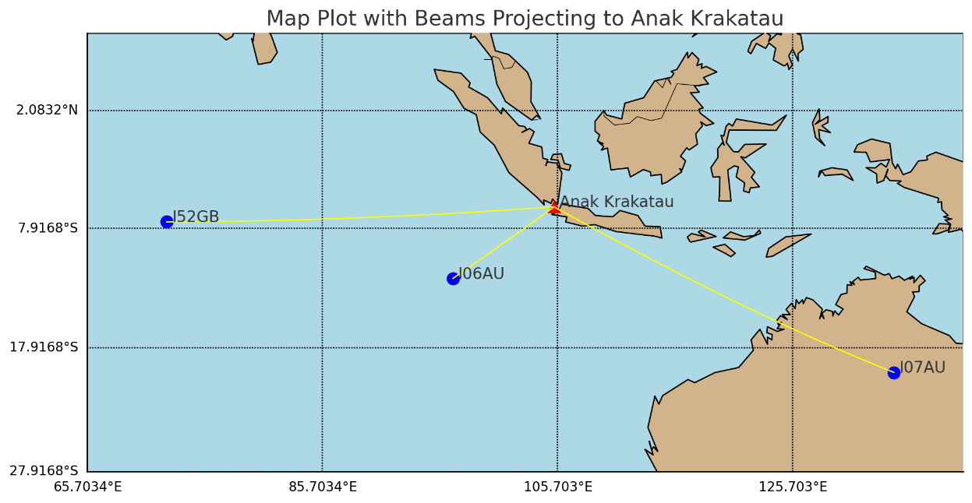
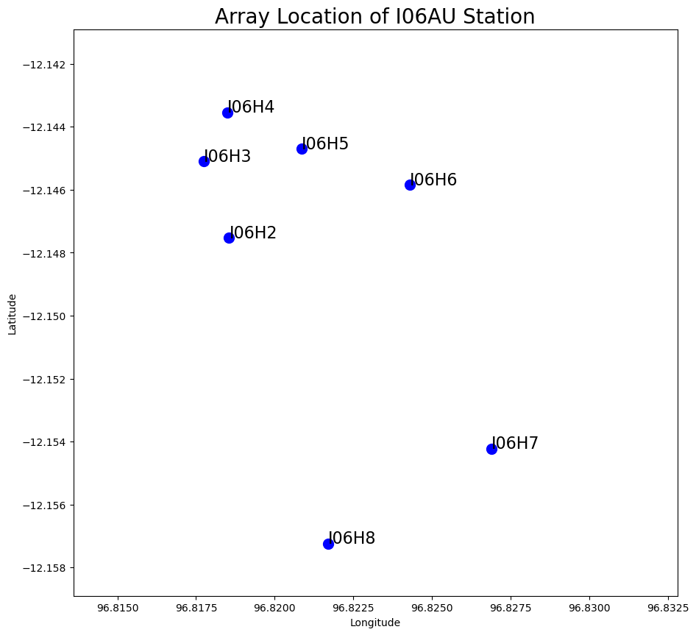
III
Methods: Data Source
Array | Sensors | Anak Krakatau
 |  | Distance (km) | Back-azimuth (̊)
106AU | 8 | 1158 | 55
107AU | 8 | 3479 | -67
139PW | 7 | 3568 | -114
152GB | 7 | 3639 | 94
Notes:
Dataset kita diambil dari 4 stasiun, I06AU, I07AU, I52GB, dan I39PW. Tetapi, karena kurangnya data yang tersedia selama observasi, kita hanya bisa menggunakan I06AU dan I52GB. I06AU sendiri, terletak pada sebuah pulau di bagian selatan indonesia; yaitu pulau Cocos. Stasiun ini terdiri dari 8 array: I06H1, I06H2, I06H3, I06H4, H5, H6, H7, dan H8. Semua data yang kami ambil bersifat open source, dan bisa di akses khalayak umum

Slide 8
III
Methods: Observation and Data Splitting
Phase | Date/Time UTC (2018-2020) | Description of Volcanic Activity
Phase 0 | June 18 - December 21 | Initial activity, characterized by Strombolian explosions with a range of intensities, ash plumes less than 5 km and lava flows
Phase 1 | December 22 - December 30 | Collapse and transition to explosive and Surtseyan style eruptions with high level plumes over 10 km
Phase 1A | December 22 - 00:00-13:50 | Intense Strombolian activity, possible lava flow on SW flank, ejected incandescent material reaching the sea
Phase 1B | December 22, 13:50-14:00 | Collapse of Anak Krakatau cone and generation of tsunami
Phase 1C | December 22, 14:00-16.55 | Propagation and impact of tsunami and three phreatomagmatic eruptions, directly after collapse at 13:55, 15:25, and 15:55
Phase 1D | December 22, 16.55 - December 28, 05:05 | Sustained high level plume with intermittent pulsing and SO2 detected
Phase 1E | December 28 - December 30 | No sustained plume from satellite and ramp down in geophysical observations
Phase 2 | January 2019 | After a pause another period of high level plumes and the rebuilding of the island
Phase 3 | February 2019 - time of writing | Sporadic eruptions
Training & Testing
Validation
Perttu (2020)
Notes:
Observasi kita ada pada Periode 2018 sampai 2019. Tepatnya, kita akan mengambil 3 fase selama erupsi gunung anak Krakatau tahun 2018. Phase 0 adalah fase awal yang terdiri dari ledakan Strombolian, fase 1 adalah ketika terjadi nya erupsi surtesyan, fase 2 adalah ketika terjadi pembangunan ulang (rebuilding) dari pulau Krakatau, dan fase terakhir yang terdiri dari erupsi sporadic.
Pembagian fase ini penting terutama untuk data splitting. Fase 0 sampai 2 kita pakai untuk training dan testing, sedangkan fase ke-3 kita akan pakai untuk validasi

Slide 9
IV
Results and Analysis
Identifying seismo-acoustic signals related to volcanic activity
1
6
Notes:
Pada tahap ini,

Slide 10
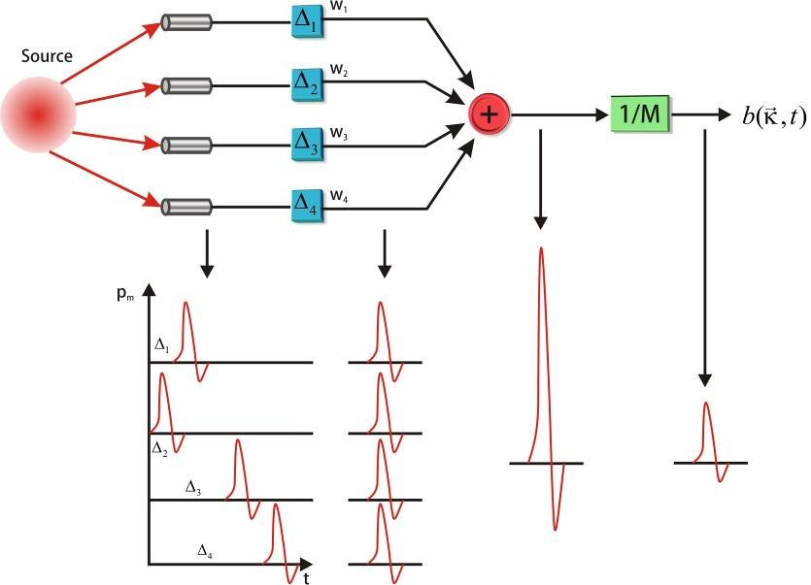


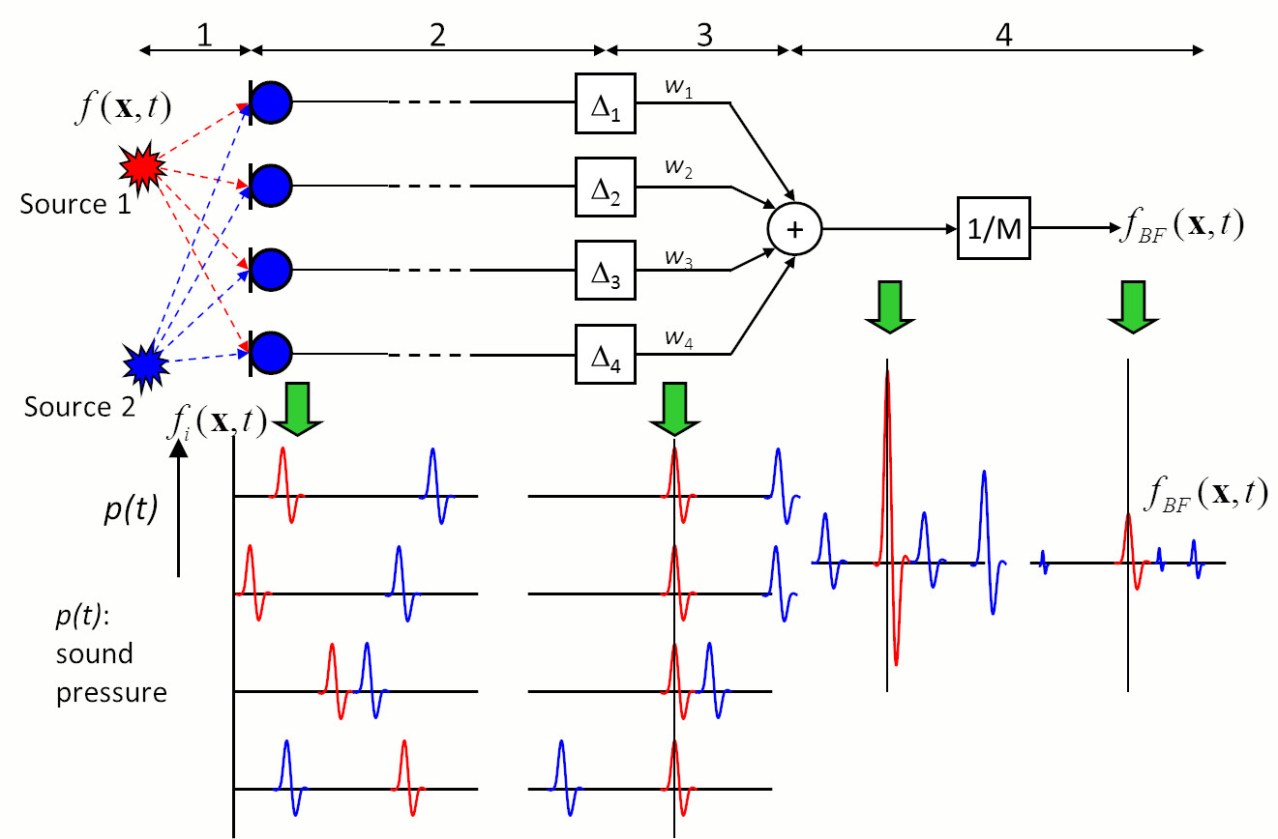
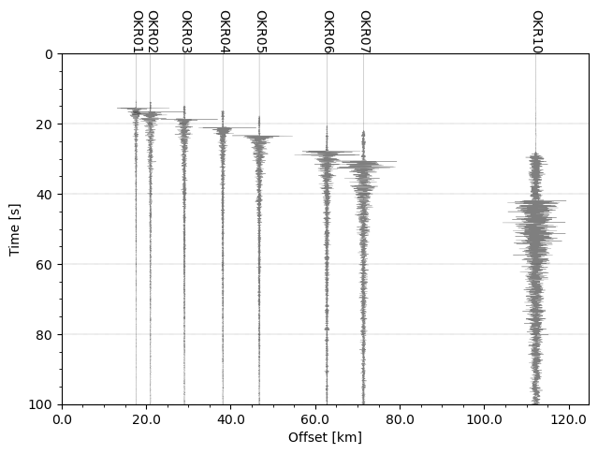
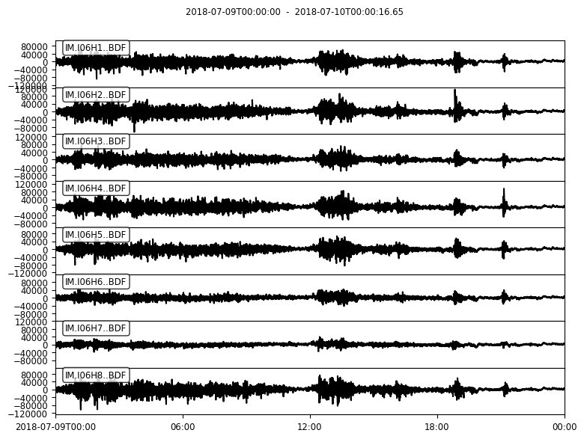
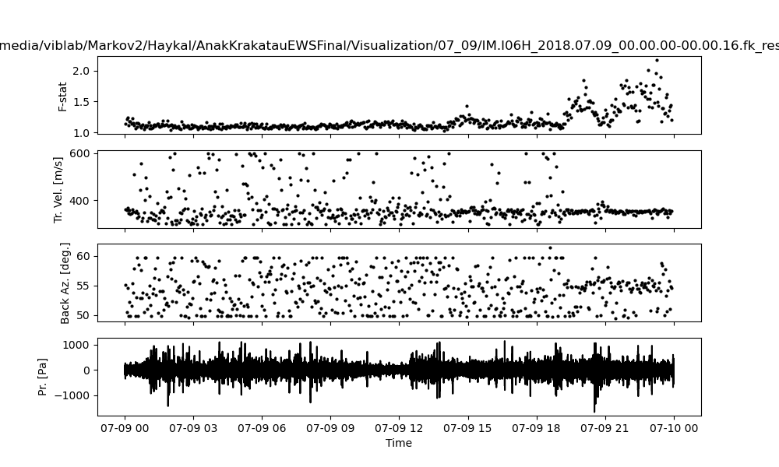
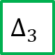
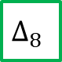
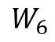

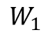


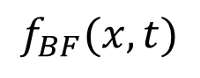

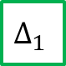
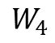



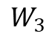
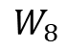
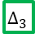

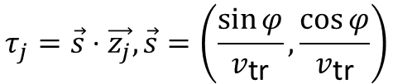
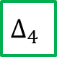
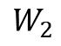
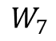
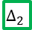
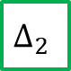

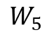

IV
Research Results
I06H1
$$∆_{1}$$
$$W_{1}$$
Anak Krakatau Volcano
I06H2
$$∆_{2}$$
$$W_{2}$$
Bartlett Beamforming
I06H3
$$∆_{3}$$
$$W_{3}$$
[-6.102, 105.423]
Lag time: 3311.0 s Range: 1158.81 km Back-azimuth: 55.31
I06H4
$$∆_{4}$$
$$W_{4}$$
+
$$1/M$$
$$f_{BF}(x,t)$$
I06H5
$$∆_{5}$$
$$W_{5}$$
I06H6
$$∆_{6}$$
$$W_{6}$$
$$\vec{𝒳}\left(f\right)=𝒢\left(f\right)\vec{Φ}+\vec{𝒩}\left(f\right), \vec{Φ}\left(f,\vec{τ}\right)=e^{−2iπf\vec{τ}}$$
I06H7
$$∆_{7}$$
$$W_{7}$$
$$τ_{j}=\vec{s}⋅\vec{z_{j}},\vec{s}=\left(\frac{\sin{φ}}{v_{\text{tr}}},\frac{\cos{φ}}{v_{\text{tr}}}\right)$$
Noise
I06H8
$$∆_{8}$$
$$W_{8}$$
I06H2
I06H3
I06H4
I06H5
I06H6
I06H7
I06H8
I06H1
I06H1
$$∆_{1}$$
$$∆_{2}$$
$$∆_{3}$$
I06H2
$$∆_{4}$$
$$∆_{5}$$
$$∆_{6}$$
I06H3
$$∆_{7}$$
$$∆_{8}$$
Pressure [Pa]
I06H4
I06H5
I06H6
I06H7
I06H8
Time
Notes:
Bartlett beamforming adalah sebuah bentuk delay-and-Sum Beamforming, ada berapa asumsi yang digunakan
1. Suara dari setiap sumber merambat ke setiap mikrofon melalui jalur yang berbeda.
2. Sinyal yang ditangkap oleh mikrofon serupa dalam bentuk gelombang, namun menunjukkan penundaan(lag) dan fase yang berbeda. Keduanya sebanding dengan jarak yang ditempuh.
3. Sinyal setiap mikrofon digeser dengan perbedaan runtime yang sesuai, bergantung pada titik fokus. Akibatnya komponen sinyal Anak Krakatau di semua saluran berada dalam fase, sedangkan komponen sinyal yang berasal dari Noise berada di luar fase.
Dari Bartlett beamforming, kita mendapatkan 3 nilai: F-statistic, yang merupakan nilai dari Signal-to-Noise (snr) power ratio, Trace Velocity, yang diambil dari slowness/time delay, dan juga Backazimuth, atau yang kita katakan sebagai angle of arrival.

Slide 11
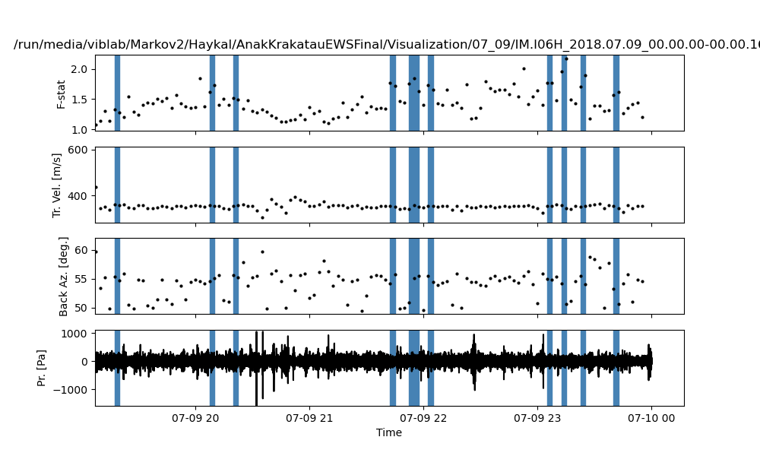
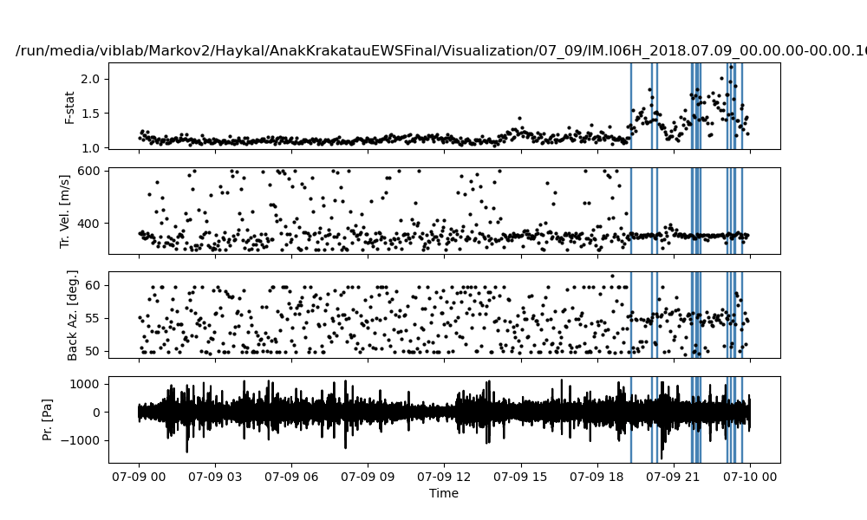
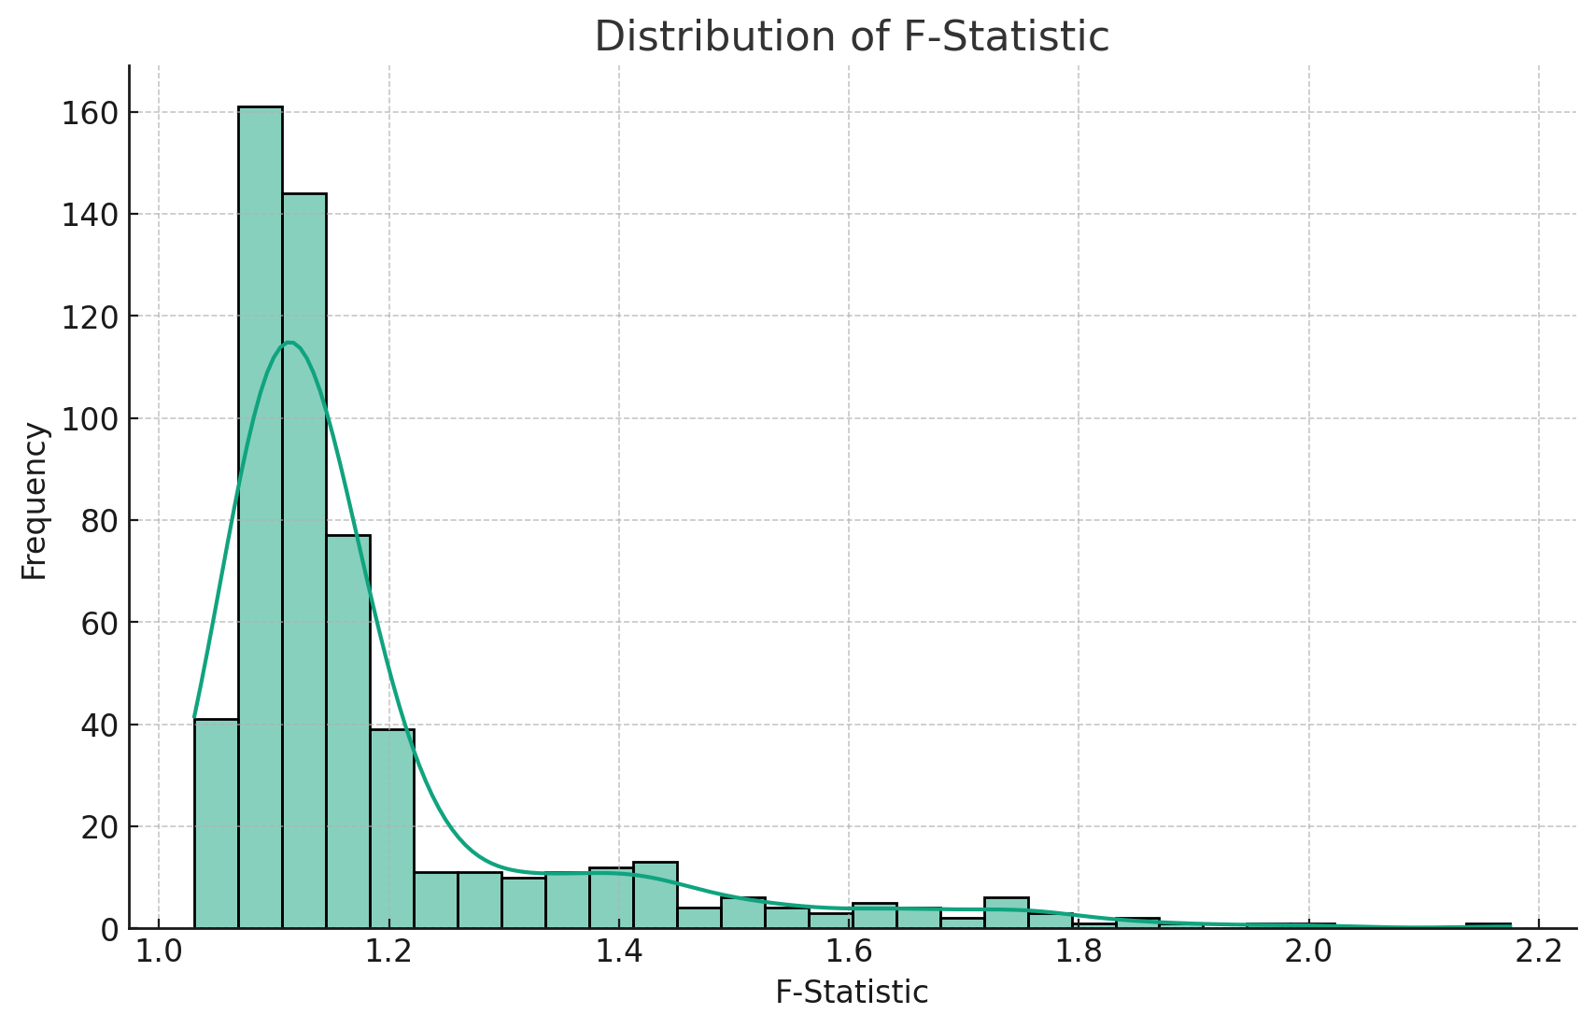
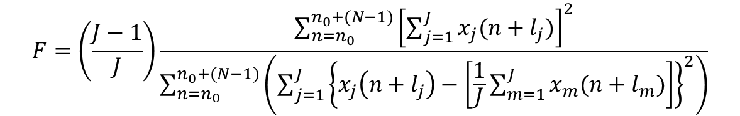
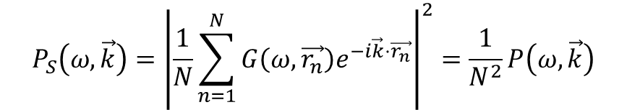
IV
Research Results
Adaptive F-Detector
The Fisher statistic is based of frequency-wavenumber (f/k) spectra. The f/k power spectral density function
1
2
3
4
5
6
7
8
9
10
$$P_{S}\left(ω,\vec{k}\right)={\left|\frac{1}{N}\sum_{n=1}^{N}{G\left(ω,\vec{r_{n}}\right)e^{−i\vec{k}⋅\vec{r_{n}}}}\right|}^{2}=\frac{1}{N^{2}}P\left(ω,\vec{k}\right)$$
Which includes both noise and signal. The F-statistic is a measure of snr power ratio, therefore the F-ratio is defined as:
$$F=\left(\frac{J−1}{J}\right)\frac{\sum_{n=n_{0}}^{n_{0}+(N−1)}{{\left[\sum_{j=1}^{J}{x_{j}(n+l_{j})}\right]}^{2}}}{\sum_{n=n_{0}}^{n_{0}+(N−1)}{\left(\sum_{j=1}^{J}{{\left\{x_{j}\left(n+l_{j}\right)−\left[\frac{1}{J}\sum_{m=1}^{J}{x_{m}(n+l_{m})}\right]\right\}}^{2}}\right)}}$$
No | F-Stat | Trace Vel. (m/s) | Back Azimuth
1 | 1.3258 | 361.25 | 55.31
2 | 1.7313 | 356.91 | 55.08
3 | 1.5221 | 357.23 | 55.64
4 | 1.7678 | 354.42 | 54.2
5 | 1.8481 | 358.55 | 55.06
6 | 1.7308 | 354.53 | 55.47
7 | 1.7746 | 354.79 | 54.97
8 | 2.1751 | 345.58 | 50.63
9 | 1.893 | 355.23 | 53.97
10 | 1.6124 | 345.38 | 50.65
8
Notes:
F statistic, yang dikalkulasi dari Bartlett Beamforming kemudian dipakai dalam Adaptive F-Detector untuk memilih segmen-segmen yang dianggap relevan dalam observasi,

Slide 12
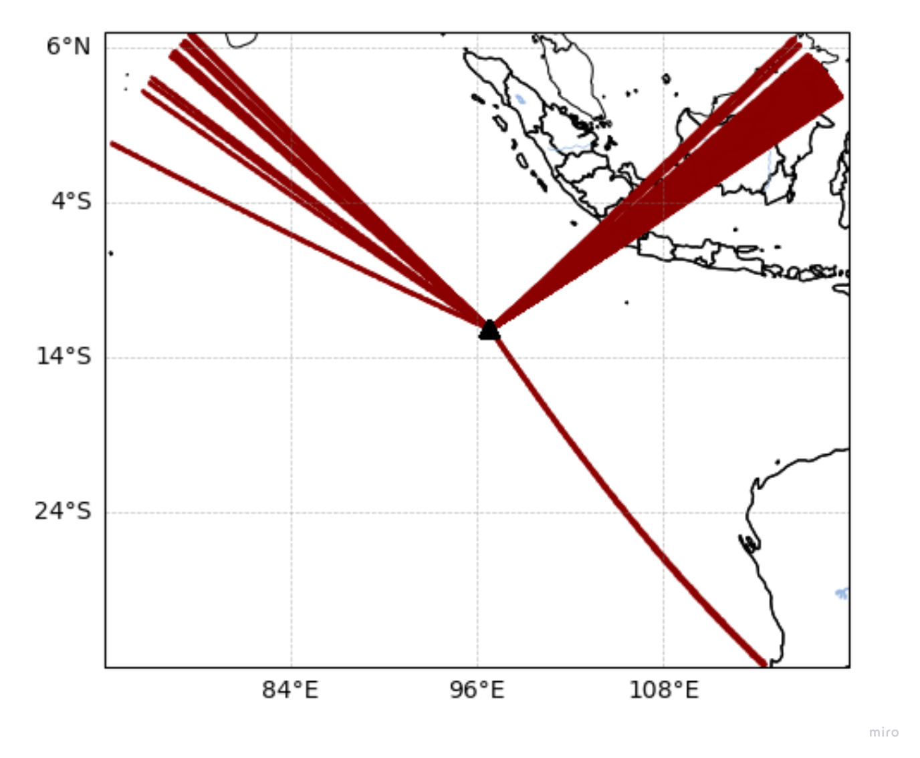
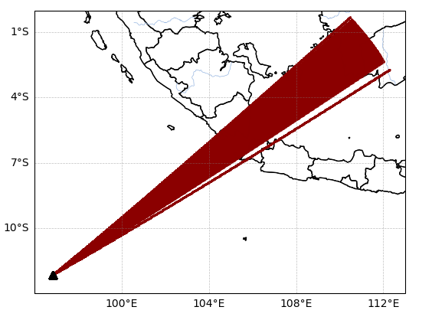
IV
Research Results
Figure 4.1.3 I06AU Adaptive F-Detector results mapping based on backazimuth values. a) AFD results of mapping 360̊ backazimuth value b) Filtered backazimuth AFD results from 50̊ - 60̊
9

Slide 13
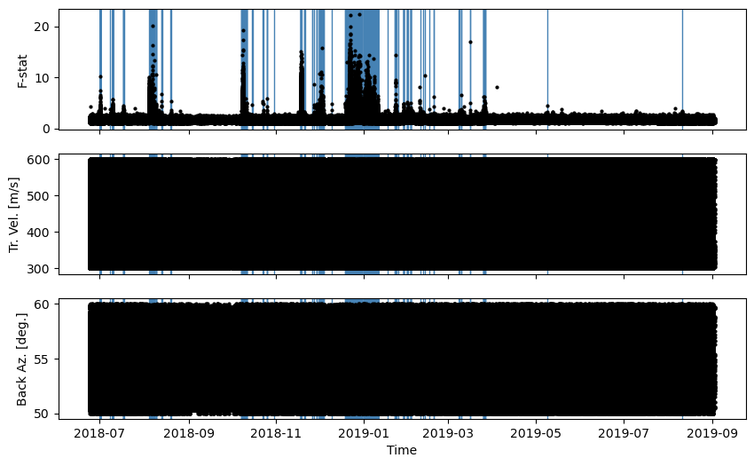
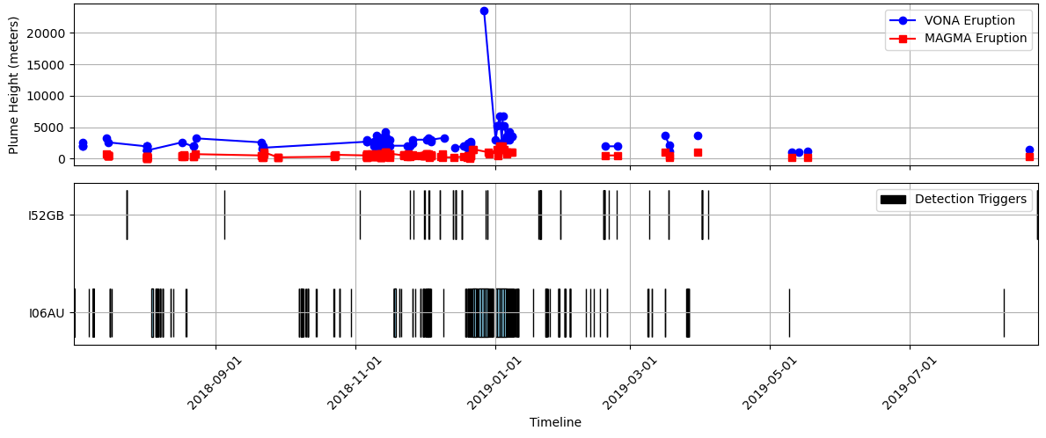
IV
Research Results
F-Stat and AFD results on I06AU Station during unrest
Stations | Detection Triggers
I06AU | 4658
I52GB | 563
I07AU | -
8

Slide 14
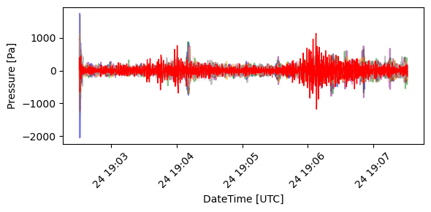
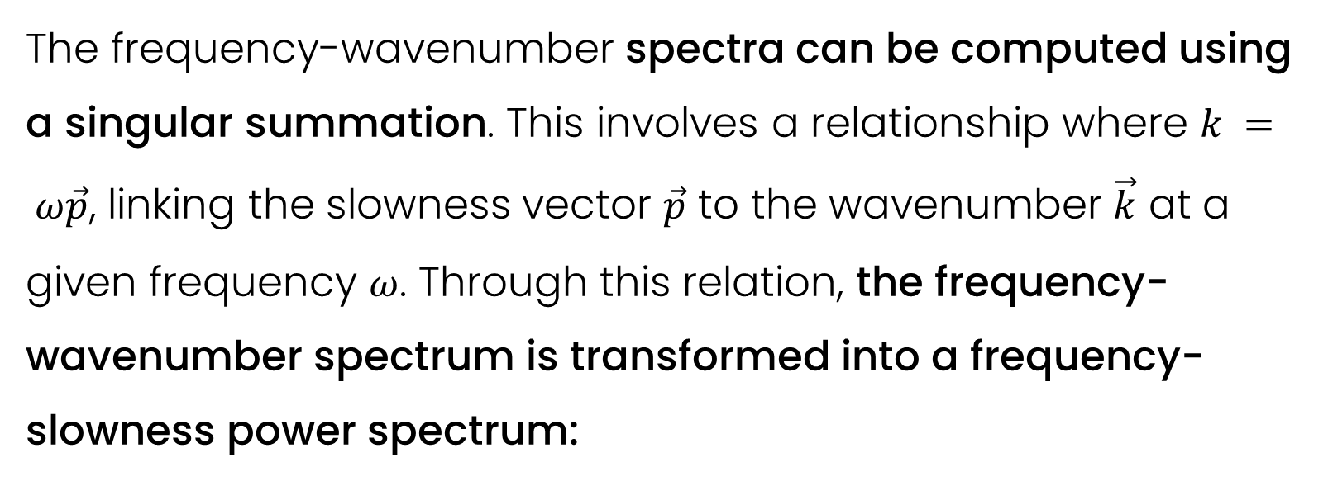
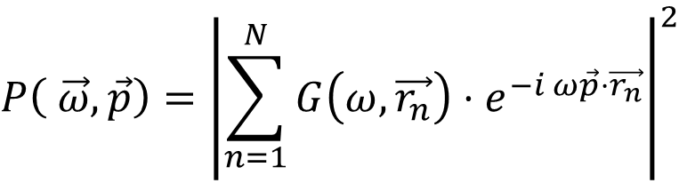
IV
Research Results
Laslo’s Best Beam
I06H1
I06H4
I06H7
I06H2
I06H5
I06H8
I06H3
I06H6
Best Beam
The frequency-wavenumber spectra can be computed using a singular summation. This involves a relationship where $k = ω\vec{p}$, linking the slowness vector $\vec{p}$ to the wavenumber $\vec{k}$ at a given frequency $ω$. Through this relation, the frequency-wavenumber spectrum is transformed into a frequency-slowness power spectrum:
$$P\left( \vec{ω},\vec{p}\right)={\left|\sum_{n=1}^{N}{G\left.\left(ω, \vec{r_{n}}\right.\right)⋅e^{−i ω\vec{p}⋅\vec{r_{n}}}}\right|}^{2}$$
10
Notes:
Noise adalah masalah utama dalam array processing. Walaupun kita sudah mendapatkan segmen-segmen yang dianggap memiliki relevansi terhadap aktivitas anak Krakatau, hal tersebut belum menihilkan adanya noise yang dapat menggangu processing selanjutnya.
Mengambil hasil dari Adaptive F-Detector, kami menggunakan Laslo’s Best beam method, yang akan menggabungkan ke-8 sinyal tersebut berdasarkan trace velocity dan juga backazimuth.

Slide 15
IV
Results and Analysis
2
Deep Embedded Clustering of Seismo-Acoustic Detection
14

Slide 16
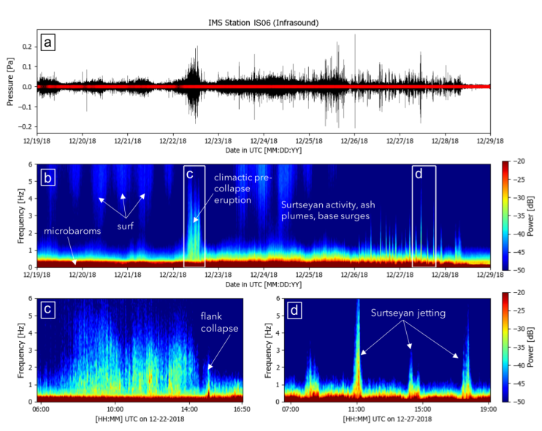
IV
Research Results
Spectral Characteristics of Seismo-Acoustic Signals
Rose (2020) has suggested that the continued broadband pulses until December 28 can be identified as Surtseyan activity
Perttu (2020) has observed an infrasound signal begins about eight hours before the main collapse. During this period, two seismic signals indicating minor mass movements and a brief period of calm were detected before the major collapse.
Rose (2020)
10

Slide 17
IV
Research Results
Autoencoder Network Architecture
ENCODER
DECODER
LATENT SPACE
[1024]
[24]
[1024]
[ ] = Shape
[8, 2, 64]
[8, 2, 46]
[16, 4, 32]
[16, 4, 32]
[32, 8, 16]
[32, 8, 16]
Encoded bottleneck for Deep Embedded Clustering (DEC)
[64, 16, 8]
[64, 16, 8]
STFT INPUT
[128, 32, 1]
[128,32, 1]
Frequency Bin
Time Bin
Channel
10
Notes:
Autoencoder model neural network yang mempelajari data input dan berusaha untuk melakukan rekonstruksi terhadap data input tersebut pada output
Autoencoder biasa digunakan untuk mengurangi dimensi dari features (Dimensionality Reduction).
Autoencoder terdiri dari dua bagian utama yaitu encoder dan decoder. Diantara keduanya, ada sebuah latent space atau “encoded result” dimana merupakan jumlah dimensi yang kita harapkan untuk mengurangi dimensi dari data

Slide 18
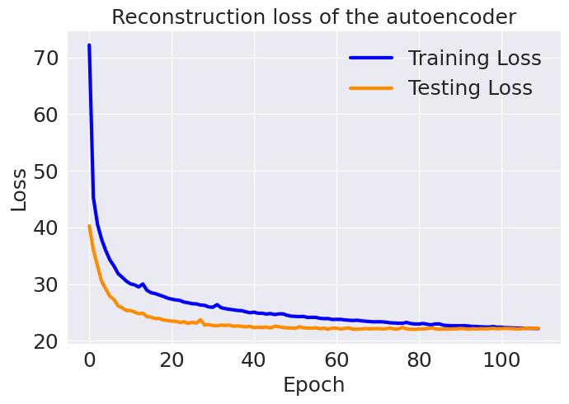
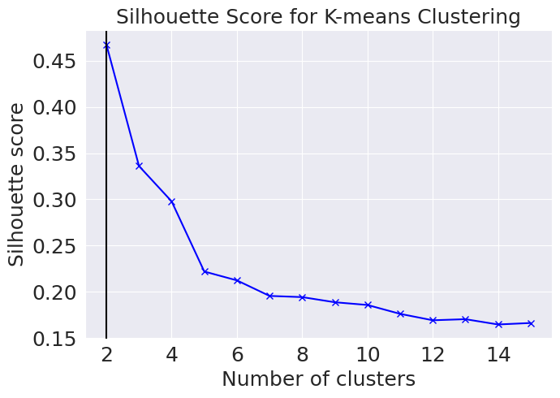
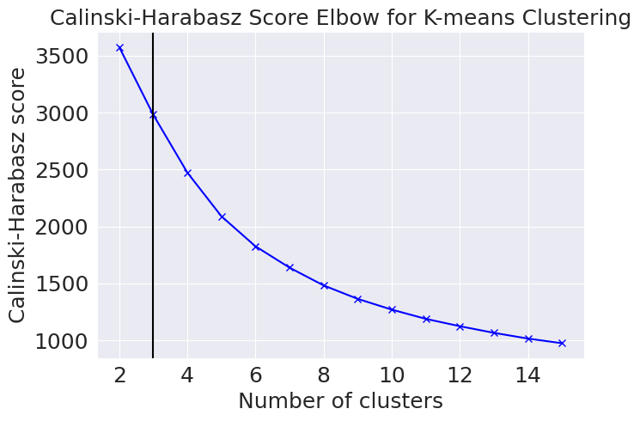
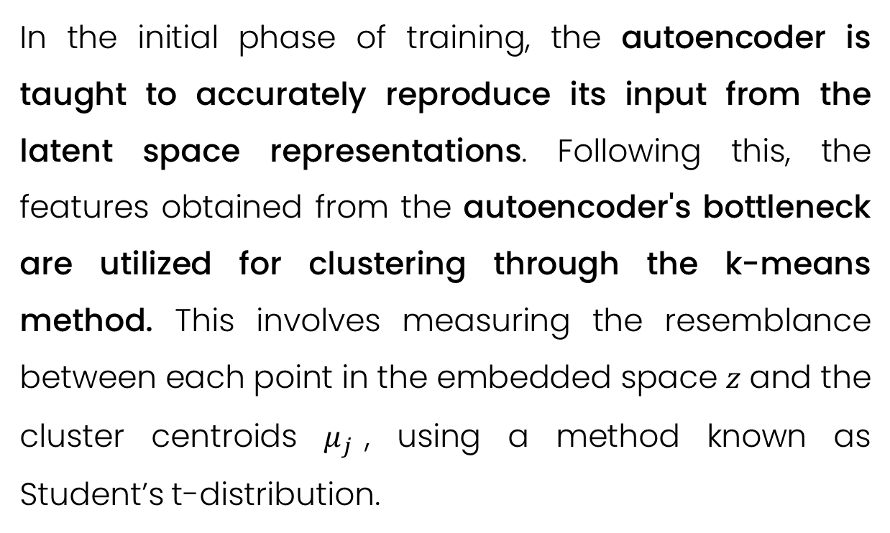
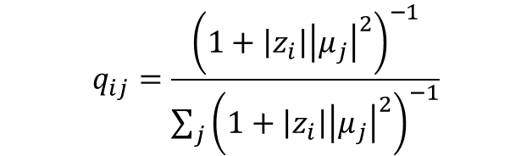
Training & Testing
IV
Research Results
In the initial phase of training, the autoencoder is taught to accurately reproduce its input from the latent space representations. Following this, the features obtained from the autoencoder's bottleneck are utilized for clustering through the k-means method. This involves measuring the resemblance between each point in the embedded space 𝑧 and the cluster centroids $μ_{j}$, using a method known as Student’s t-distribution.
$$q_{ij}=\frac{{\left.\left(1+\left|z_{i}\right|{\left|μ_{j}\right|}^{2}\right.\right)}^{−1}}{\sum_{j}{{\left.\left(1+\left|z_{i}\right|{\left|μ_{j}\right|}^{2}\right.\right)}^{−1}}}$$
Results show a training MSE value of 22.167, which; relatively to testing losses are very close in values. It suggests that the model is not overfitting and that the autoencoder is performing well.
10
Notes:
Selanjutnya, ketika input STFT sudah dimasukan pada autoencoder, input tersebut akan di dekonstruksi dan direkonstruksi ulang sebagai sebuah gambar STFT spectrogram. Hasil yan gkami dapat adalah ketika training, kita mendapatkan nilai MSE sebesar 22.167. Apa yang dimaksud dengan MSE ini? Kita akan bahas di 2 slide selanjutnya
Tidak hanya itu, encoded result yang merupakan bagian latent space ini bisa kita pakai untuk memberikan kategori tertentu pada data yang kita punya (unsupervised clustering) Dalam penentuan berapa kategori yang akan diciptakan, kita menggunakan Sillhoete score dan Elbow Method; dimana kita menemukan nilai ideal sebesar 3 cluster

Slide 19






Training & Testing
IV
Research Results
t-SNE Visualization
Before k-means clustering
After k-means clustering (K=3)
After fine-tuning
To further refine this, an additional target distribution, denoted as $p_{ij}$, is computed. This is achieved by leveraging the membership probabilities represented by $q_{ij}$, as described in the following manner:
In the fine-tuning stage, the clustering layer aims to reduce the Kullback–Leibler (KL) divergence. This process is focused on aligning the soft assignments, represented by 𝑞.2, more closely with the target distribution, denoted as $p_{ij}$.
$$p_{ij}=\frac{q_{ij}^{2}/\sum_{i}{q_{ij}}}{\sum_{j}{\left(q_{ij}^{2}/\sum_{i}{q_{ij}}\right)}}$$
$$L=KL(P|\left|Q\right)=\sum_{i}{\sum_{i}{p_{ij}\log\left(\frac{p_{ij}}{q_{ij}}\right)}}$$
10
Notes:
Gambar yang paling kiri, adalah visualisasi keseluruhan data kami pasca training
Gambar ditengah, adalah data ketika kami berikan k=3, dan dapat dilihat ada pembagian data berdasarkan jenis
Gambar paling kanan, merepresentasikan data setelah Fine Tuning:

Slide 20



Training & Testing
IV
Research Results
Clustering Results
Continuous Tremor 1
Continuous Tremor 2
Explosive Activity
RAW STFT
DECODED
STFT results reveal key aspects of seismic signatures. The raw data exhibits a more textured distribution of energy across the frequency spectrum, with noticeable energy concentrations in certain frequency bands that suggest consistent volcanic activity, possibly related to the movement of magma or volcanic gases.
In contrast, the decoded spectrograms present a smoother and more homogenized view of this energy distribution, indicating that the encoding process successfully abstracts the raw data while retaining its essential features
10

Slide 21
Training & Testing
IV
Research Results
Continuous Tremor 1
Particular emphasis on the lower frequency bands across the spectrograms. Continuous tremors are often dominated by such low-frequency content, indicating large-scale movement as opposed to localized, high-frequency events.
a visible presence of noise across all frequencies, which is typical for volcanic tremors.
The noise level appears to be relatively uniform and not overpowering the tremor signal
RAW STFT
DECODED
10

Slide 22
Training & Testing
IV
Research Results
Continuous Tremor 2
Energy distribution over time is relatively steady, indicating a persistent process. However, if there are subtle differences in the temporal patterns, such as more frequent energy bursts, it could reflect changes in the volcanic activity's intensity or frequency
Possibly indicating variations in the magma conduit or different levels of volcanic gas emissions
There seems to be a higher amplitude variation within this cluster compared to CT1
RAW STFT
DECODED
10

Slide 23
Training & Testing
IV
Research Results
Explosive Activity
Shows concentrated areas of higher energy at lower frequencies, which may suggest a release of energy typical of explosive volcanic events
The presence of bright spots (areas of higher intensity) in the spectrograms indicates moments of higher energy release,
Spasmodic bursts of energy could be indicative of magma fragmentation or gas release during an explosion.
RAW STFT
DECODED
10

Slide 24



Training & Testing
IV
Research Results: Revealing Evolution of 2018 Anak Krakatau Unrest
Phase 0: Initial activity, characterized by Strombolian explosions
The sporadic orange dots denoting Explosive Activity (EA) correspond with significant eruptive events, characterized by more vigorous releases of energy, as confirmed by the alignment with VONA notifications,
This clustering of EA dots around VONA notifications implies that these were notable explosive episodes.
at least nine explosions was reported took place 2-5 August 2018
Dense gray ash plumes rose 200-600 m above the summit (5-7 August )
Two sustained bursts of activity over 2 days (October 8-9, 2018)
PVMBG
10

Slide 25


Training & Testing
IV
Research Results: Revealing Evolution of 2018 Anak Krakatau Unrest
Phase 1: Collapse and transition to explosive and Surtseyan style eruptions
Shows a persistent and increasing level of seismic activity, which aligns with the geological interpretation of the volcano undergoing a collapse and transitioning into a more explosive phase
The interplay of continuous tremors with explosive events suggests a volatile system with both ongoing magma dynamics and sudden explosive disruptions
This pattern underscores the complexity of monitoring such phases, where both the continuous movement of magma and the potential for rapid escalation to explosive activity must be closely observed
10

Slide 26


Training & Testing
IV
Research Results: Revealing Evolution of 2018 Anak Krakatau Unrest
Phase 1: Collapse and transition to explosive and Surtseyan style eruptions
Phase 1D reveals the uniformity and frequency of EA events, suggest that the activity is consistent with volcanoes exhibiting sustained eruptive activity.
Phase 1E likely reflects a period of relative quiescence following the more vigorous activity of earlier phases.
Even though it is described as an absence of a sustained plume, our detection results reveals three distinct explosive activity before a transition to a continuous eruptive plume in Phase 2, similar to the observation by A. Perttu (2020).
10

Slide 27

Training & Testing
IV
Research Results: Revealing Evolution of 2018 Anak Krakatau Unrest
Phase 2: Another period of high level plumes and the rebuilding of the island
The rebuilding of a volcanic island and the generation of high-level plumes are typically accompanied by seismic and infrasonic signals
Persistence of CT1 events and a continuous presence of CT2 and EA events during the first eriod.
The EA events, in particular, appear to be less frequent as time goes but still periodically significant.
10

Slide 28


Validation
IV
Research Results: Revealing Evolution of 2018 Anak Krakatau Unrest
Phase 3: Predicting cluster assignment on new unseen detections
the relative positioning of CT1, CT2, and EA clusters in relation to the already fine-tuned model is maintained.
The clusters in the training data appear to have a continuous flow, and this characteristic seems to be present in the new data clustering as well.
Visualization of clusters on new data reveals similar patterns with previous results
10

Slide 29

Validation
IV
Research Results
Phase 3 : Sporadic Eruptions
Timeline reflects a shift from a more continuous pattern of seismicity to one that is indicative of a less active or dormant phase, interspersed with sporadic bursts of volcanic activity.
The use of advanced machine learning models like autoencoders for prediction can enhance the ability of real-time monitoring for such unpredictable volcanic phases.
10

Slide 30
IV
Results and Analysis
3
Modeling Volcanic Activity for Forecasting Eruptions
14

Slide 31





IV
Research Results
Data is severely imbalanced due to the nature of eruption detection
The “enc_23” feature in the plot has the highest value of importance, suggested it is frequently used in making splits and a significant predictor for the target variable
Feature Selection Method
Feature Extraction Method (PCA)
10

Slide 32


IV
Research Results
Feature Selection Method
Feature Extraction Method (PCA)
The “enc_23” feature in the plot has the highest value of importance, suggested it is frequently used in making splits and a significant predictor for the target variable
Feature selection method is fitting the training data better than it is fitting unseen data. However, the gap is not widening significantly as iterations increase, which is a good sign that the model isn't overfitting severel
PCA Method shows a smaller gap between training and validation MAE, suggesting that the model with PCA components may generalize better on unseen data,
10

Slide 33

IV
Research Results
Feature Selection Method
Feature Extraction Method (PCA)
Metric | Score
Mean Absolute Error (MAE) | 75.711
Root-mean-square deviation (RMSE) | 127.9062
Coefficient of Determination (R²) | 0.644
Metric | Score
Mean Absolute Error (MAE) | 73.41
Root-mean-square deviation (RMSE) | 106.44
Coefficient of Determination (R²) | 0.7541
10

Slide 34
IV
Results and Analysis
4
Conclusion
14

Slide 35
II
Conclusion
1
Compiled a technique for isolating seismo-acoustic signals related to volcanic activity using a single regional station.
2
Deep learning method offers a quick, accurate and reproducible way to uncover patterns in the temporal evolution of Anak Krakatau Volcano
3
Eruption forecasting still has limitations and requires further work to enhance its reliability and accuracy.
2
Notes:
Maka dari itu, dapat disimpulkan tujuan atau objective dari studi ini akan

Slide 36



Thank You

Slide 37


Conv2D
Flatten

Slide 39








EVENT 1
EVENT 1
I06AU
EVENT 3
EVENT 2
I52GB
EVENT 3
EVENT 3

